Slide 1
MARKET BASKET OPTIMISATION
Association Rule Learning : Apriori and Eclat
Khushi Srivastava

Slide 2
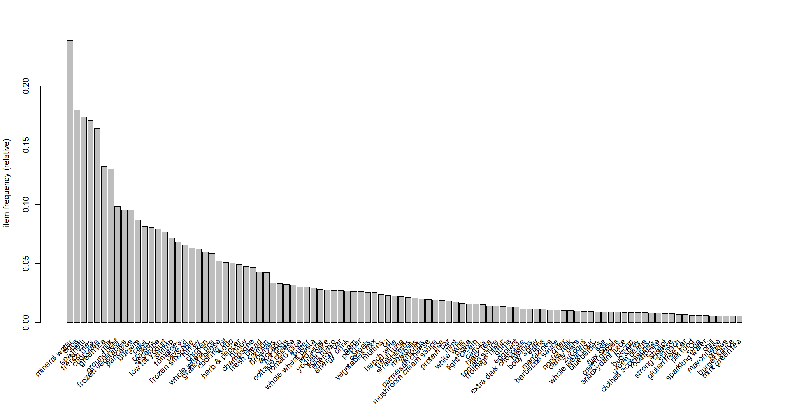
APRIORI : Item Frequency Plot (Top 100)

Slide 3
VISUALISING ASSOCIATION: support = 0.003, confidence = 0.2
# | LHS | RHS | Support | Confidence | Coverage | Lift | Count
1 | {mineral water, whole wheat pasta} | {olive oil} | 0.003866151 | 0.4027778 | 0.009598720 | 6.115863 | 29
2 | {frozen vegetables, milk, mineral water} | {soup} | 0.003066258 | 0.2771084 | 0.011065191 | 5.484407 | 23
3 | {fromage blanc} | {honey} | 0.003332889 | 0.2450980 | 0.013598187 | 5.164271 | 25
4 | {spaghetti, tomato sauce} | {ground beef} | 0.003066258 | 0.4893617 | 0.006265831 | 4.980600 | 23
5 | {light cream} | {chicken} | 0.004532729 | 0.2905983 | 0.015597920 | 4.843951 | 34
6 | {pasta} | {escalope} | 0.005865885 | 0.3728814 | 0.015731236 | 4.700812 | 44
7 | {french fries, herb & pepper} | {ground beef} | 0.003199573 | 0.4615385 | 0.006932409 | 4.697422 | 24
8 | {cereals, spaghetti} | {ground beef} | 0.003066258 | 0.4600000 | 0.006665778 | 4.681764 | 23
9 | {frozen vegetables, mineral water, soup} | {milk} | 0.003066258 | 0.6052632 | 0.005065991 | 4.670863 | 23
10 | {french fries, ground beef} | {herb & pepper} | 0.003199573 | 0.2307692 | 0.013864818 | 4.665768 | 24

Slide 4
Terms..
#: Rule number or index.
LHS: The left-hand side of the rule, which is the antecedent or the set of items that are found together.
RHS: The right-hand side of the rule, which is the consequent or the item that is predicted to be associated with the items on the left-hand side.
Support: The proportion of transactions in the dataset that contain both the items on the left-hand side and the right-hand side of the rule.
Confidence: The likelihood that the right-hand side (RHS) of the rule will be bought when the left-hand side (LHS) is bought. It is the ratio of Support(LHS ∩ RHS) to Support(LHS).
Coverage: The proportion of transactions in the dataset that contain the items on the left-hand side of the rule.
Lift: The ratio of Confidence to the expected Confidence if the items on the left-hand side and the right-hand side were independent of each other.
Count: The number of transactions that support the rule.

Slide 5
ECLAT : Item Frequency Plot (Top 100)

Slide 6
VISUALISING ASSOCIATION: support = 0.003, minlen = 2
# | Items | Support | Count
1 | {mineral water, spaghetti} | 0.05972537 | 448
2 | {chocolate, mineral water} | 0.05265965 | 395
3 | {eggs, mineral water} | 0.05092654 | 382
4 | {milk, mineral water} | 0.04799360 | 360
5 | {ground beef, mineral water} | 0.04092788 | 307
6 | {ground beef, spaghetti} | 0.03919477 | 294
7 | {chocolate, spaghetti} | 0.03919477 | 294
8 | {eggs, spaghetti} | 0.03652846 | 274
9 | {eggs, french fries} | 0.03639515 | 273
10 | {frozen vegetables, mineral water} | 0.03572857 | 268

